Slide 1

A Compton Imaging Detector Integrated With a Robotic System as a Radiation Survey Tool
Final Presentation Practice
Aaron Belman-Wells, Caleb Bush, and Giuliano Fonte Basso
Mentors: James Berry and Dr. He

Slide 2
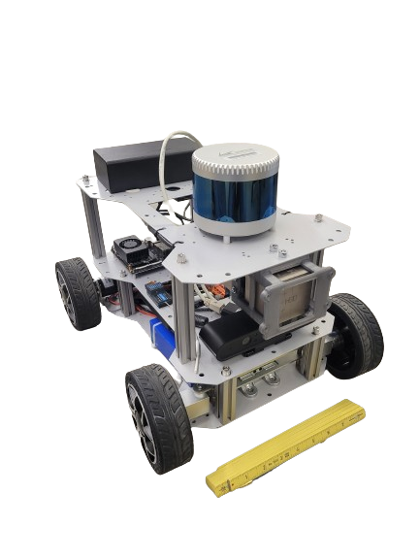
Introduction
LiDAR
We are continuing a previous senior design team and had access to their code.
Robot chassis for driving around
Equipped with LiDAR, IMUs, and a Jetson TX1 computer.
Centerpiece: M400 Detector
Pixelated CZT detector capable of determining energy and location of interaction within its volume.
M400
Detector
Jetson TX-1

Slide 3
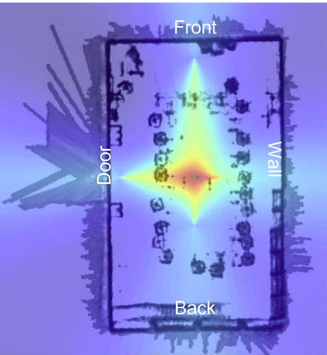
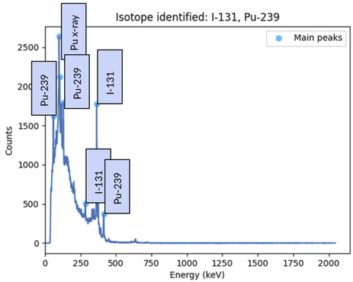
Last Year’s Progress
Localization to find source.
Could find source to 21 cm.
Spectroscopy to identify source.
Identified isotopes in 3002 spectra with 99.6% accuracy.
Done with ideal data - no background.
[A]
[A]

Slide 4
Project Background
In order to minimize people’s exposure to radiation, we need a robot that can do everything a person would.
Other robots exist to collect a source from a known position and safely transport it elsewhere.
A human worker can locate a source very precisely by seeing how intensity increases as they move closer to it.
Our robot can’t get as close to the source, so must make up for that deficiency.

Slide 5
Design Requirements
Precise Localization: robot must be able to locate a weak (60 μCi) Cs source to within 15 cm.
Accurate Spectroscopy: robot must be able to identify any single weak radioisotope with 95% accuracy.
Fast Operation: time from final data collection to complete report must not exceed 60 s.
All data must be processed at least as fast as it comes in.

Slide 6
Methods

Slide 7
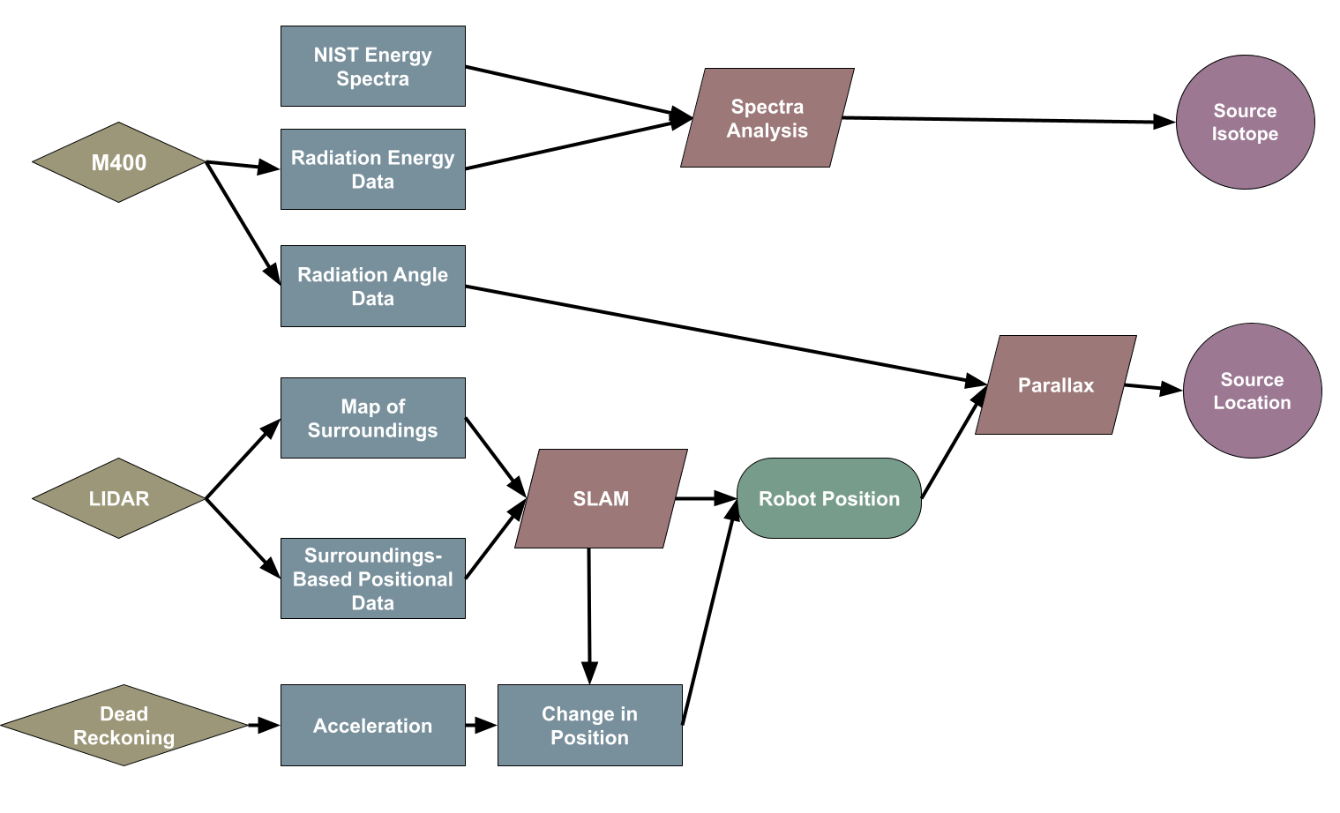
Methods

Slide 8
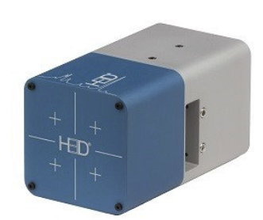
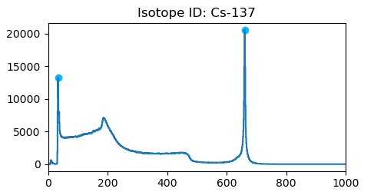
Spectroscopy Methods
Live M400 Data
csv or N42
Data Parsed and smoothened
Savkov and FindPeak
Peak matching
Based on NIST set
Data
H3D M400
¹³⁷Cs
FWHM = 0.71%
Processing
Counts
Energy (keV)
NIST Data

Slide 9
Compton Scattering Methods

Slide 10
Localization Methods
Information about the location of the robot is collected via a combination of IMUs, LiDAR, and odometry.
Inertial Measurement Units - Detects translational and rotational acceleration.
Odometry - Counts wheel turns and angles.
Light Direction and Ranging - Determines distance to nearest surfaces in 270° arc.
Data from each detector is collected by ROS before being reformatted and processed in Python.
LiDAR is imprecise but can be used to reset IMUs and odometers, which drift over time.

Slide 11
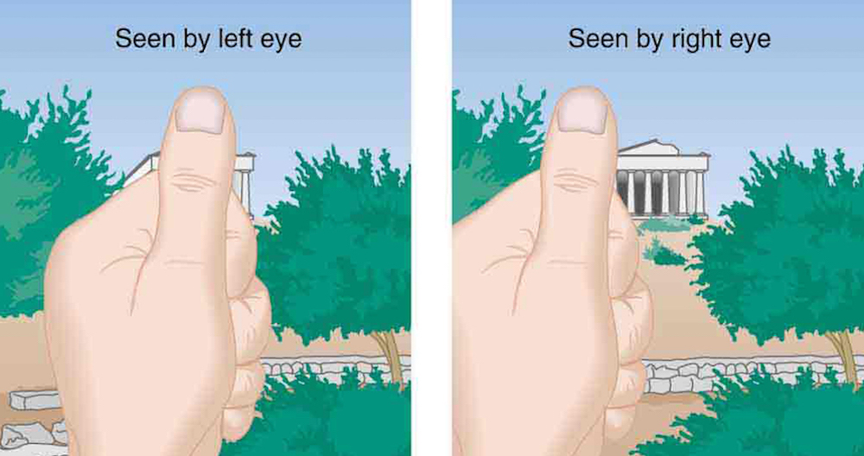
Localization Methods
Once the direction from the robot to the source is known, that can be combined with the position of the robot to create a ray passing through the source.
Also need direction the robot is facing.
Multiple rays from different positions intersect at one point - the source.
Minimize the mean absolute distance from all lines, preventing outliers from throwing off estimate.
[B]

Slide 12
Results

Slide 13
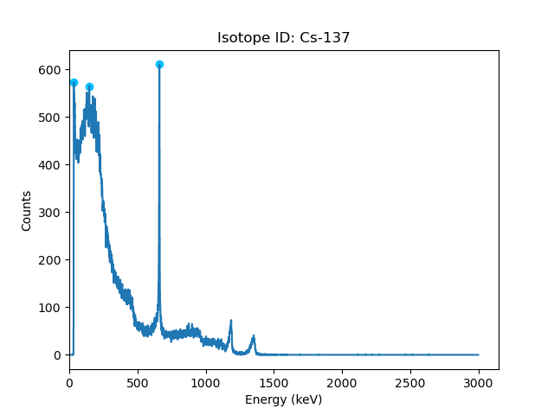
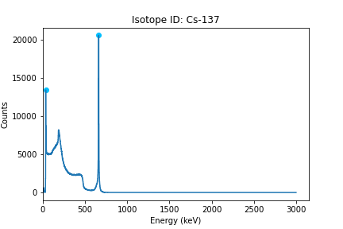
Results - Spectroscopy
Limited Real Sources

Slide 14
Results - Compton Imaging

Slide 15
Results - Position Finding
Excellent over short ranges - drift of 0.1% while going straight forward.
More drift results from sharper turns and higher speeds - be gentle.
If mapping a large area, make sure that surroundings are suitable for LiDAR position finding.
Not a problem in the test cases that have been run so far.

Slide 16
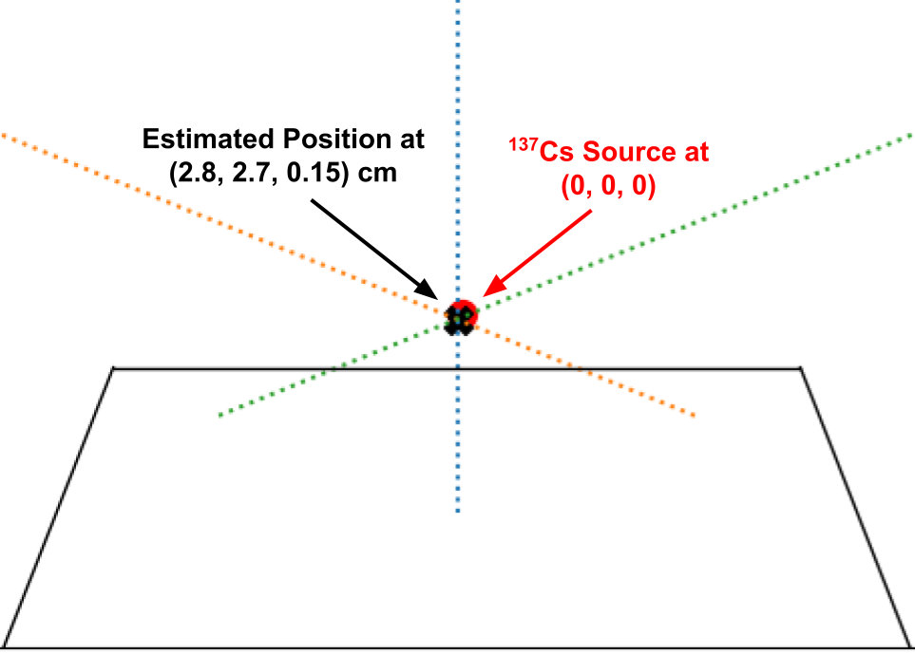
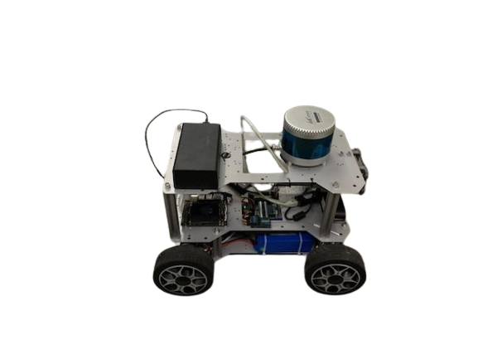
Results - Robot as a Whole
A source was located with an error of 3.9 cm, well within the required range.
This experiment took 5 minutes to perform.
Source position was known, so no time was spent looking for region of source.

Slide 17
Conclusion
We are perfect.
Future Work
Robot can only track one source at a time.
Would be simple to set it up to track an arbitrary number of different radioisotopes.
Detect multiple instances of the same radioisotope and track them.
Pieces of ¹³⁷Cs scattered about after an accident.

Slide 18
Acknowledgements
James Berry - significant technical assistance with the robot and pointing us to resources.
Dr. He -
Staff of the ORION Lab - help with programs and access to check sources.

Slide 19
References
https://www.joyceproject.com/notes/080008parallax.htm
https://www.dropbox.com/home/NERS%20591?preview=RadicalRobotics_FinalOralPresentation_Submission1.pptx

Slide 20
Questions

